Slide 1

On Demand Enterprise Delivery Platform

Slide 2
Table of Contents
Introduction
Team
Problem
Solution
Business Model
Competition Analysis
Competitive Advantages
Financing
Product Overview
Application
Technology Stack
Project TimeLine
SWOT Analysis

Slide 3
Problem
Most of core business applications aren’t known for their scalability, flexibility, and speed.
Company could not survive in the digital world without renovating core enterprise solution.
Creating a new solution from the scratch is cost and time inefficient.

Slide 4
Problem (continued)

Slide 5
Solution
Orion is an affordable standalone on-demand solution for any business or startup platform.
Provides a full stack of services.
The platform is flexible and scalable.
Orion allows to launch your on-demand platform on both mobile and web devices.

Slide 6
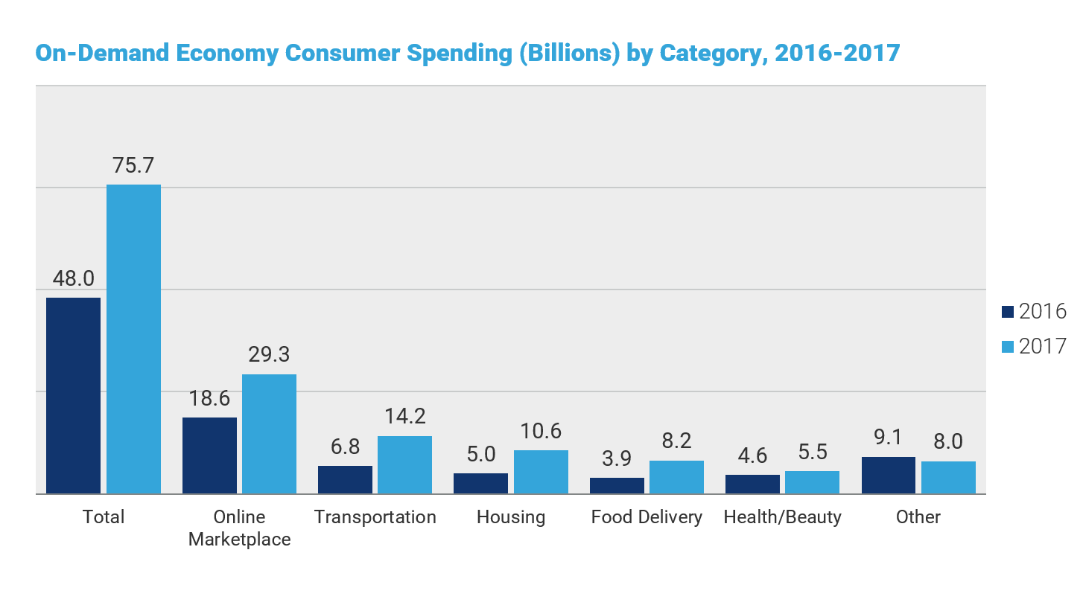
Market Validation

Slide 7
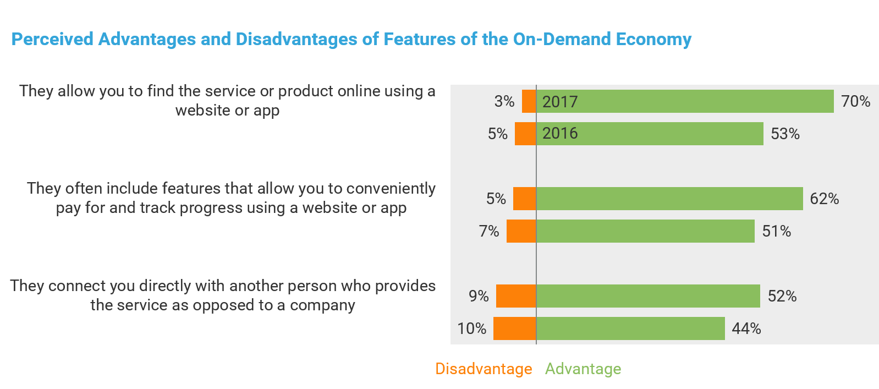
On-demand Economy Model

Slide 8
Our Team
Roman Pelevin - A technology delivery leadership expert with over 22 years of experience, Roman Pelevin has successfully consulted, founded and led numerous web and mobile technology projects.
Alexandr Kobelev - A architectural software designer and expert with over 20 years of experience, Alexander Kobelev has led different development team with high success.
Renat Babin - Marketing expert with over 5 years of experience, has successfully been involved in various marketing campaigns.

Slide 9
Business Model

Slide 10
Business Model (continued)
Clients
branding
PRODUCT
ORION
businesses
Reporting
maintenance

Slide 11
Revenue Model
Integration of our platform involves setup cost $6,000 - $8,000.
$10 per Service Provider.
Maintenance fixed cost is $500 a month.
Customization costs.

Slide 12
Competition Analysis
Indirect competition: Any on-demand application such as Uber, AirBNB, Turo, etc.
Direct competition:

Slide 13
Competitive Advantages
Orion provides custom branding for each client.
We have the most affordable prices.

Slide 14
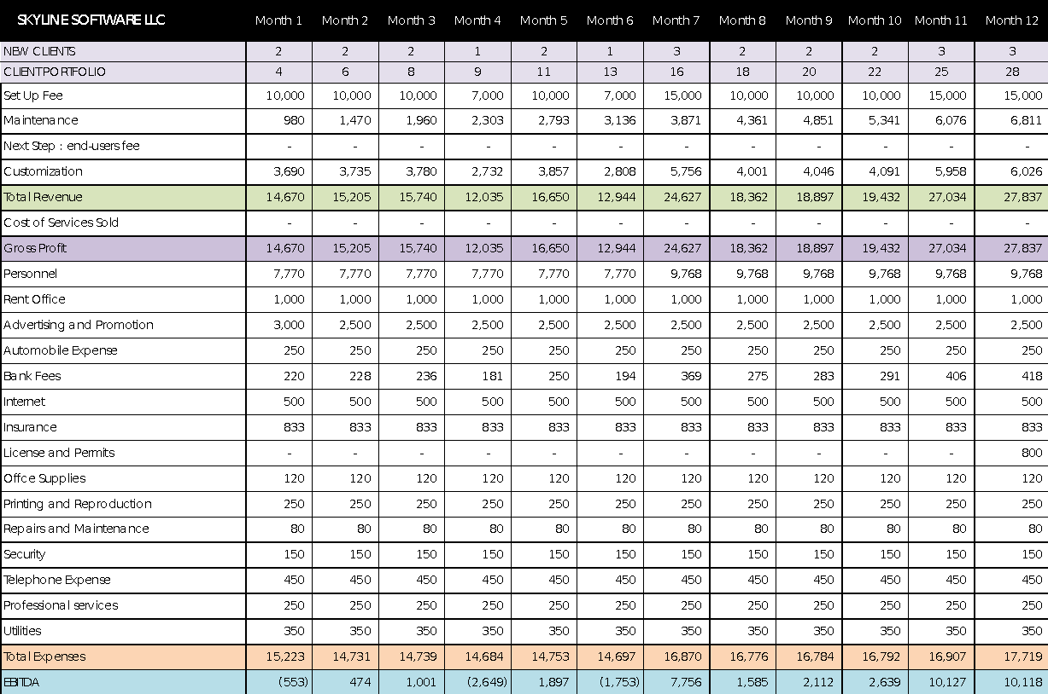
Financing

Slide 15
Product Overview
Enterprise solution/platform that would allow businesses to implement the dispatching/tracking system into their business processes and introduce the on-demand business model to their companies.
We power all types of businesses including pickup & delivery, beauty services, health and well being, home services, mobile workforce, repair services, etc.

Slide 16
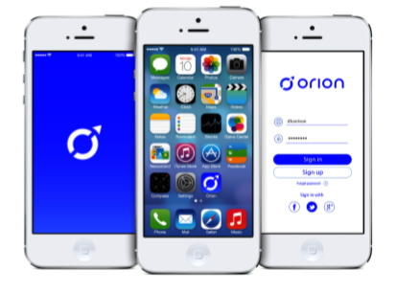
Application: Administration Dashboard
Real-time tracking and dispatching
Notifications and Alerts
Automate Logistics
Powerful Analytics

Slide 17

Application: Service App
Task Notification
Optimized Routes
Proof of Delivery
Easy Navigation

Slide 18



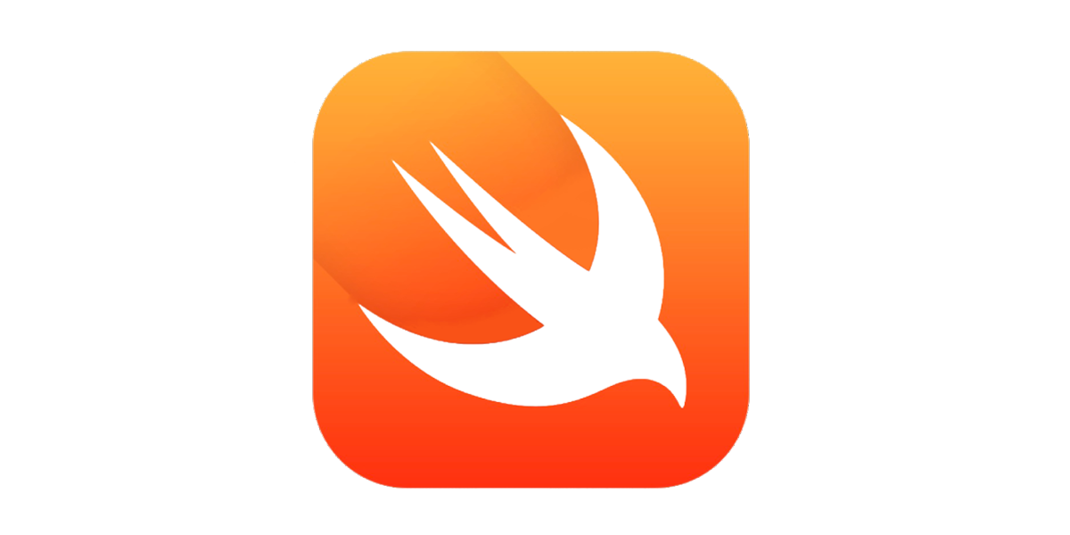
Technology Stack

Slide 19

SWOT Analysis

